Slide 1
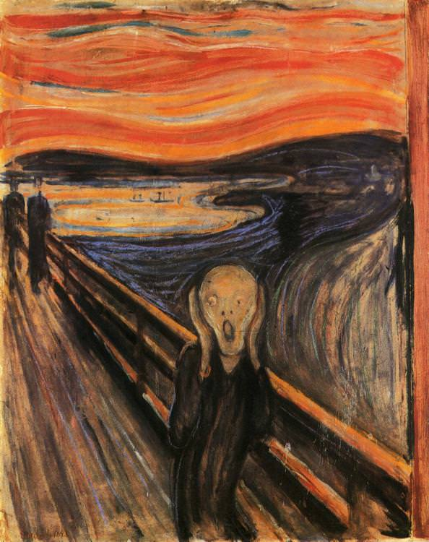
Pain
Prof. Deepthi de Silva
Department of Physiology

Slide 2
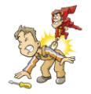
At the end of this lecture you should be able to
State the classification of pain
State the stimuli causing pain & outline the mechanisms activating pain receptors
State the differences between fast and slow pain
Outline the pain pathway
Outline the mechanism modifying pain transmission at the dorsal horn
Outline the descending analgesic system
Neurosciences module

Slide 3

Pain- Definition
“Physical adjunct of an imperaprotective reflex”
- (Charles Sherrington)
“Unpleasant sensory & emotional experience associated with actual or impending tissue damage or described in terms of that damage”
- (International association for the study of pain)
Neurosciences module

Slide 4
Essential as a warning-
  absence of pain sensation can be harmful
Influenced by psychological factors-
  Soldiers injured during battle may feel little pain
  Chronic pain helped by psychological intervention
Neurosciences module

Slide 5
Classification of pain
Physiological/ Acute pain
Acute onset and lessens with healing
Essential protective mechanism
Pathological/ Chronic pain
Persists even after injury healed
Post inflammation
  Chemicals from injured tissue increase sensitivity of pain receptors
Neuropathic pain
Neurosciences module

Slide 6
Pain
Somatic
Superficial
  Origin from skin
  E.g. pinching, cutting, burning
Deep
  From bones, joints, muscles
  E.g. Cramps, arthritis
Visceral
Pain originating from internal organs or structures
  E.g. Appendicitis, heart attack
Neurosciences module

Slide 7

Pain Receptors
Neurosciences module

Slide 8
Pain Receptors
Free nerve endings of Aδ and C fibres
Slow adapting- may even increase sensitivity (hyperalgesia)
Respond to stimuli that cause tissue damage
  Mechanical* (e.g cutting, pinching)
  Thermal* (e.g. very high /low temperatures)
  Chemical (e.g. Bradykinin, Potassium,,
  serotonin, substance P)
  - Polymodal (Combination of above)
  * High threshold
Neurosciences module

Slide 9
Direct Stimulation of Nociceptors
Receptors on nerve endings called transient receptor potential channels (TRP)
  E.g TRPV 1 stimulated by heat, acid, chemicals or via TRVP3 receptors
  TRPA1 stimulated by noxious mechanical, chemicals or cold stimuli
  Acid sensing ion channels (ASIC) mediate H+ induced pain

Slide 10
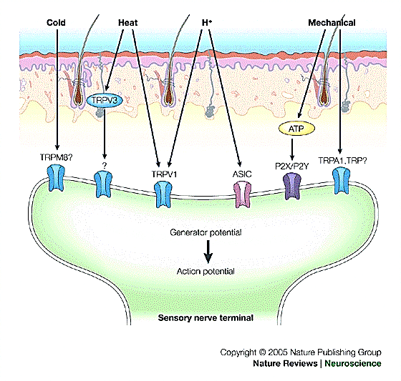
Nature Reviews Neuroscience 6, 521-532 (July 2005)
Neuroscience module
D de Silva

Slide 11
Indirect stimulation of nociceptors
Nociceptive stimulus
Chemicals released
Act on nociceptors
Noxious mechanical stimuli release
  ATP: Acts on purinergic receptors
  Nerve growth factor : acts on tyrosine receptor kinase A
Immune reactions release substances
  Bradykinin, prostaglandins, interleukins: act on specific receptors in nerve terminals
Neurosciences module

Slide 12
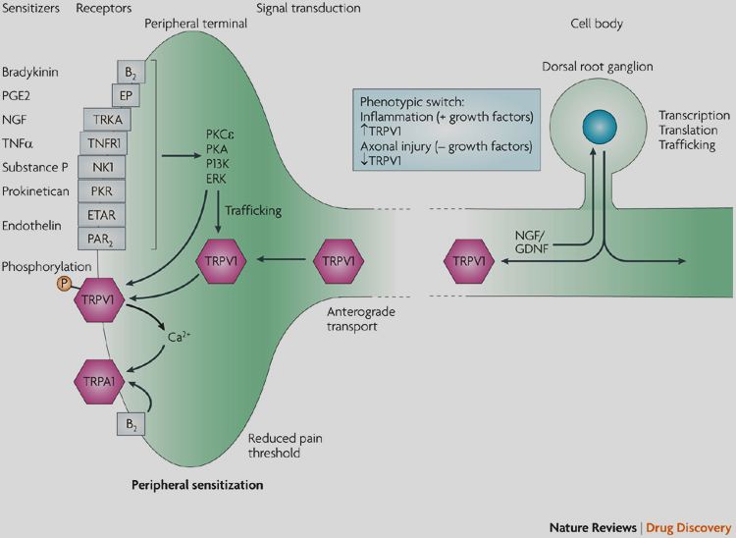
Nature Reviews Drug Discovery 8, 55-68 (January 2009)

Slide 13
Pain Pathway
Neurosciences module

Slide 14
Afferent fibres
Aδ (myelinated)
1-5µm
20-30% of pain afferents
C fibres(unmyelinated)
< 1µm
70- 80% of pain afferents
Cell bodies lie in the dorsal root (or trigeminal) ganglia
Axons terminate in the dorsal horn
Neurosciences module

Slide 15
Fast and slow pain
Fast pain- mediated by Aδ fibres
Sharp, well localised pain
Rapid onset
Slow pain – Mediated by C fibres
Dull & aching pain
Poorly localised
Slower rate of onset
Neurosciences module

Slide 16
The dorsal horn
δ fibres in lamina I and V
  Mainly mechanical and acute thermal pain
  Neurotransmitter - Glutamate
C fibres terminate in lamina I & II
  All 3 types of pain (mechanical, thermal, chemical)
  Neurotransmitter - Substance P, glutamate
Neurosciences module

Slide 17
Ascending pain pathway-
Neospinothalamic tract
Contralateral spinothalamic tract-fast pain
  Synapse at VPL thalamic nuclei
  Project via internal capsule to primary and secondary somatosensory cortex, cingulate gyrus
  Involved in recognizing location & severity of pain
Neurosciences module

Slide 18
Ascending pain pathway 2- Paleospinothalamic tracts
Transmit mainly slow pain
Project to many brain areas including
  Reticular formation and tectal area
  Peri aqueductal grey matter
From these areas to centrolateral thalamic nuclei
  via these areas to hypothalamus, cortical & limbic areas
  Involved in regulating response to pain

Slide 19
VPL nucleus
(thalamus)
Centrolateral
Nuclei of
Thalamus
Fast pain
fibres
Slow pain
fibres
Reticular formation
Neurosciences module

Slide 20
Deep somatic pain
From muscles, tendons, periosteum (poorly supplied with A δ fibres)
Afferents are mainly C fibres
  Mainly slow pain
Poorly localised
Associated with
  nausea, sweating
  Contraction of skeletal muscles near damaged area
Neurosciences module

Slide 21
VISCERAL PAIN
Neurosciences module

Slide 22
At the end of this lecture you should be able to
Outline the causes of visceral pain
State the differences between somatic and visceral pain
State that visceral pain can be localised to overlying skin and referred to a distant structure
Outline the visceral pain pathway
Outline the physiological basis for referred pain including the dermatome rule
Outline the basis for phantom limb pain
Outline the physiological basis for types of analgesia
Neurosciences module

Slide 23
Visceral pain
From pain receptors of internal organs
  Less nociceptors than skin
Some viscera have no pain receptors (e.g.liver, alveoli, brain)
  their coverings (liver capsule, dura, parietal peritoneum, pericardium & pleura) have nociceptors
Highly localized damage may not cause pain but diffuse stimulation can be painful
  e.g cutting a small section of gut is pain free;
  ischemia of large part of intestine painful
Notes:
Viscera have no proprioceptors; few thermoreceptors, touch receptors

Slide 24
Causes of visceral pain
Distension
  E.g. Over filling of bladder
Smooth muscle spasm
  E.g. ureter spasm in renal colic
  Caused by mechanical stimulation or ischaemia
Ischaemia [reduced oxygen]
  e.g. heart muscle during angina
  Acidic metabolites or inflammatory chemicals
Stretching of connective tissue
  E.g. bleeding in joint
Chemical damage
  E.g. pancreatitis, perforation of gastric ulcer
Neurosciences module

Slide 25
Afferents fibres transmitted with autonomic nerves and cranial nerves (VII, IX, X)
Transmitted with somatic fibres in CNS (spinothalamic tracts)
Visceral pain
  Diffuse and poorly localised
  Associated with sweating, nausea, vomiting, autonomic symptoms
  Reflex spasm of overlying skeletal muscle “guarding” [muscle ischaemia worsens pain]
Neurosciences module

Slide 26
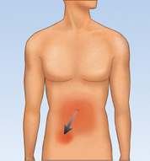
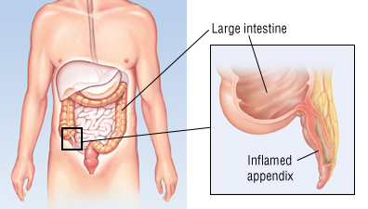
Appendicitis
Starts in peri umbilical region [referred pain]
Spreads to the right iliac fossa
[localised to
RIF]
Neurosciences module

Slide 27
Visceral pain
Referred pain
Sensation felt in skin area further away from organ
Pain fibres from viscera transmitted with autonomic fibres
Localised pain
Pain felt in area of visceral organ
Pain fibres from the connective tissue surrounding organs (parietal peritoneum or pleura, pericardium)
Transmitted to local nerves at spinal segment
Neurosciences module

Slide 28
Referred Pain;
Dermatome rule
Pain referred to a structure that has same embryological origin [dermatome rule]
  Diaphragm starts at neck and afferents from this enter cord at C2,3,4
  pain from the diaphragm referred to shoulder tip
Neurosciences module

Slide 29
Mechanism of referred pain
Convergence of pain afferents from viscus and somatic pain afferents on the same 2nd order neuron
Somatic
structure
Viscus
Neurosciences module

Slide 30
Somatic pain fibres’ EPSP not enough for AP
  Visceral pain impulses facilitates impulse transmission in 2nd order neuron
Brain cannot identify the site of origin of pain and associates it with the somatic site
  Past experience will suggest pain from somatic structure
Neurosciences module

Slide 31
Inflammatory pain
Hyperalgesia-
  Exaggerated response to painful stimuli
Allodynia
  Mild stimulus is perceived as pain
Mechanism-
  Increased pain receptor sensitivity and impulse transmission
  Due to substances released by tissue damage
Neurosciences module

Slide 32
Neuropathic pain
Following injury to nerve fibres
Phantom limb –
  pain and other sensations in amputated limb
  Cut ends of nerves from amputated limb discharge APs
  Pain or other sensation projected to area where sensory receptor occurred
Neurosciences module

Slide 33
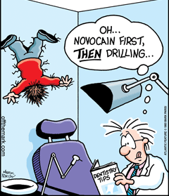
Pain relief
- Analgesia
Neurosciences module

Slide 34

The Dorsal Horn Gate

Slide 35
Dorsal horn ‘gate’
Pain transmission can be modified here
  Eg rubbing a painful area relieves pain
  Transcutaneous electrical nerve stimulation [TENS]
Aβ touch fibres inhibit pain transmission at dorsal horn
C fibre
-
+
Inhibitory
interneuron
+
2nd order
neuron
Aα or Aβ
fibre
May 2009
Neurosciences module

Slide 36
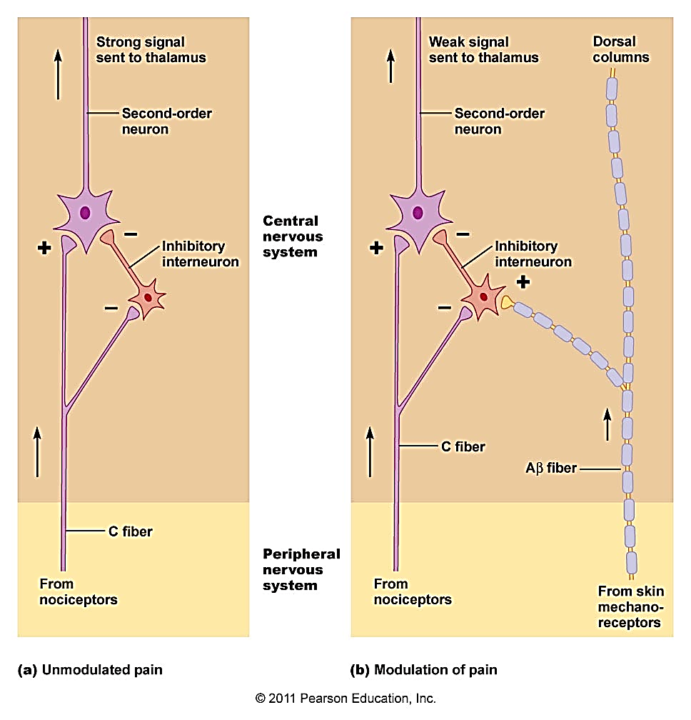

Slide 37
Inhibitory Interneurone
Secretes encephalin (endogenous opiate)
  Acts on encephalin receptor
Presynaptic membrane
  inhibits Ca++ entry & reduces neurotransmitter release (Substace P/ glutamate)
Post synaptic membrane
  Hyperpolarisation by increasing K+ efflux
Dorsal root ganglion cells
Neurosciences module

Slide 38
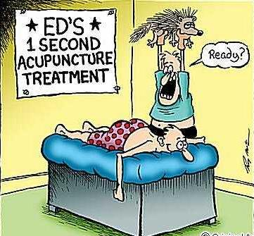
Neurosciences module

Slide 39
Descending pathway for pain relief (Descending analgesic system)
Pathways descend from brain to dorsal horn & inhibits pain transmission
Peri aqueductal gray matter
  (mesencephalon & upper pons)
  Nucleus raphe magnus (lower pons) & Rostral ventromedial medulla
Other areas via stimulating periaqueductal gray
  Periventricular nuclei
  Medial forebrain bundle
Neurosciences module

Slide 40
Descending inhibitory pathways
3rd ventricle
Aqueduct
Periaqueductal grey/
Periventricular nuclei
Peri-
aqueductal
grey
Peri-
ventricular
nuclei
NT- enkephalin
Pons
Raphe magnus
Associated nuclei
Serotonin,
Enkephalins
Noradrenaline
Raphe magnus
nucleus
Dorsal horn gate:
pre and postsynaptic inhibition of pain

Slide 41
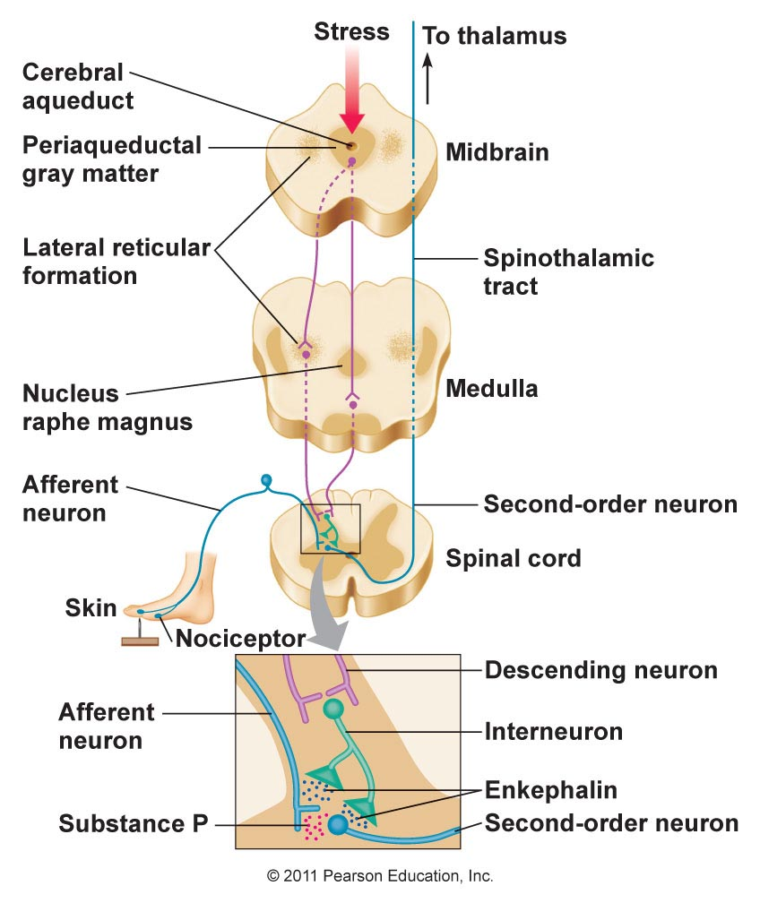
Neurosciences module

Slide 42
Analgesia- pain relief
Rubbing/ counter irritant
  Modify pain transmission at dorsal horn gate
Anti inflammatory drugs (eg aspirin)
  Reduce formation of prostaglandin (reduce pain threshold)
Acupuncture
  Via large diametre fibre stimulation +/- release of endogenous opiates
Neurosciences module

Slide 43
Local anaesthetics
  Block impulse transmission in large diameter sensory afferents
Surgical procedures
  Lateral cordotomy
Neurosciences module

Slide 44
Opiates
‘Endogenous opiates’
Include enkephalins (leu/metencephalin),
dynorphins and β endorphin
Act as neurotransmitters & analgesic agents
Morphine like drugs (opioids) used for pain relief
Act on endogenous opioid receptors
  Peripheral- skin, joints, muscles
  Dorsal horn gate- inhibit excitation of the
  2nd order neuron
  Periaqueductal grey to stimulate descending analgesic pathway

Slide 45
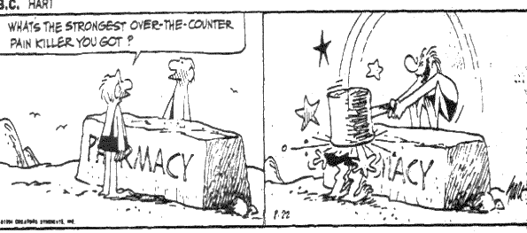
What’s the strongest over the counter pain killer you have got?
Neurosciences module

Slide 46
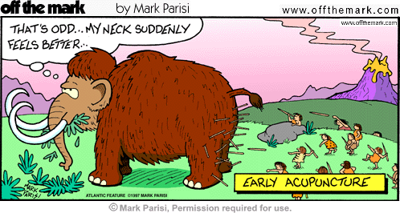
Self Study
Headache and its physiological basis
Neurosciences module

